Slide 1
File System Format
1

Slide 2
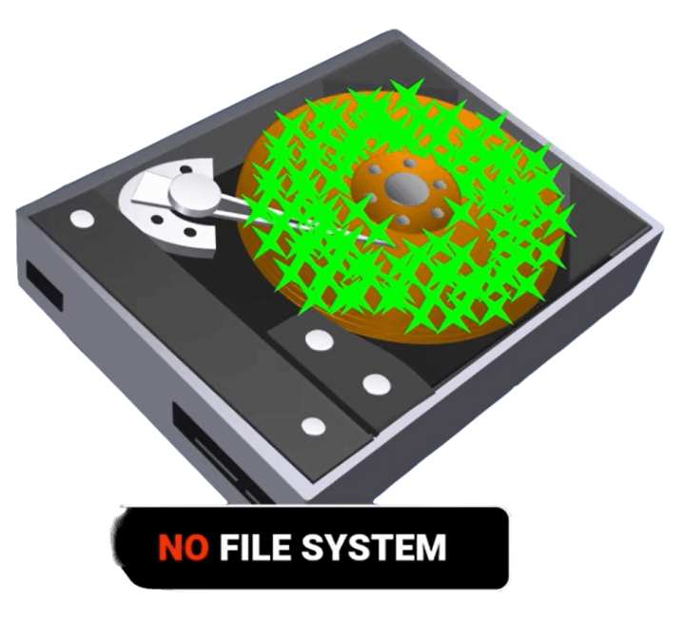
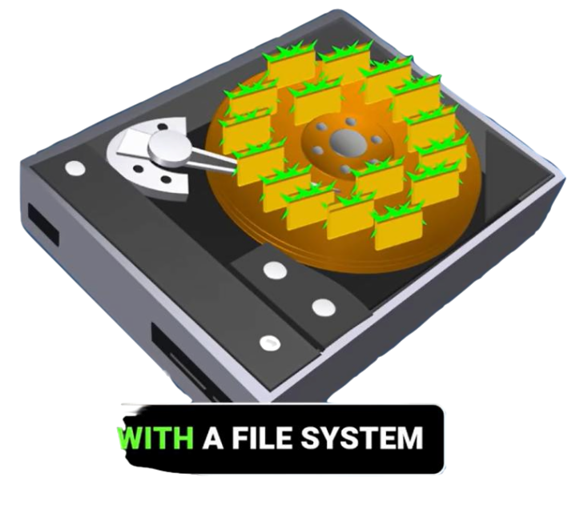
File System Format
2
File system format: refers to the structure and organization of data on a storage device such as HDD, SSD, USB Flash, CD/DVD/Blu-ray and Tape Drive atc.
File system format features include :
Data Structures.
File Metadata.
File Storage.
Access Control.
File Allocation.
Journaling.
Error Handling.
Compatibility.
Without file system
With file system

Slide 3
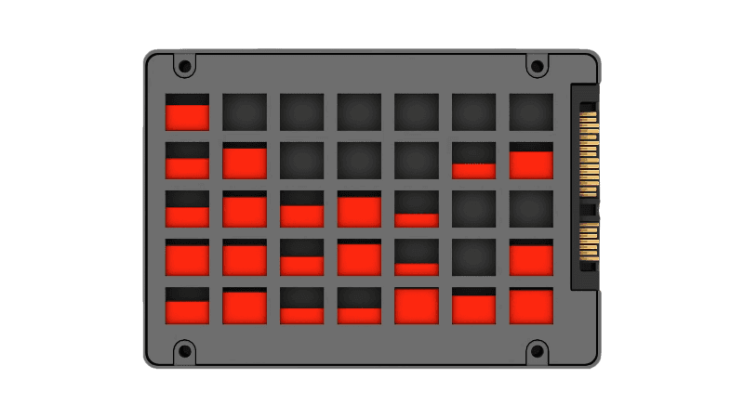
File System Format
3

Slide 4
File System Format
4
The choice of file system format depends on various factors, including:
Operating system compatibility.
Application.
Scalability.
Data safety and reliability.
File size and volume limits.
Security and encryption.
Hardware and device type.
Community.
Legacy compatibility.

Slide 5




Type File System Format
5
EXT, EXT2, EXT3, EXT4.
BTRFS.
XFS.
NTFS.
FAT32.
EXFAT.
TMPFS.
APFS.

Slide 6
Type File System Format
6
EXT (Extended File system)
EXT3 (Third Extended File system)
No longer used due to some limitation.
Ext3 includes journaling features.
Ext3 is backward compatible with Ext2.
EXT2 (Second Extended File system)
EXT4 (Fourth Extended File system)
Ext2 uses an inode-based system to manage files and directories.
Ext4 is the default and most widely used file system in modern Linux distributions RHEL, Debian, Ubuntu.
support individual files with sizes of up to 16TB.
support partition with sizes of up to 1EB.

Slide 7
Type File System Format
7
XFS (X File System)
BTRFS (B-Tree File System)
In Red Hat Enterprise Linux (RHEL) 7, the default file system format used is XFS.
Scalability.
File system Check Speed.
Journaling.
support up to a 16 EB partition (sixteen times of the data of Ext4) and a file of the same size as ext4.
Copy-on-Write.
Data Deduplication.
Compression.
TMPFS (Temporary File System)
APFS (Apple File System)
The file is stored in volatile memory instead of a permanent storage device.
is a modern, efficient file system used by Apple devices for storage.

Slide 8
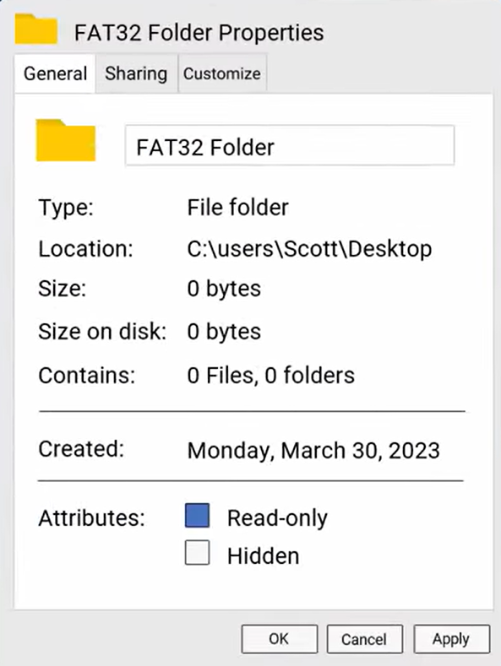
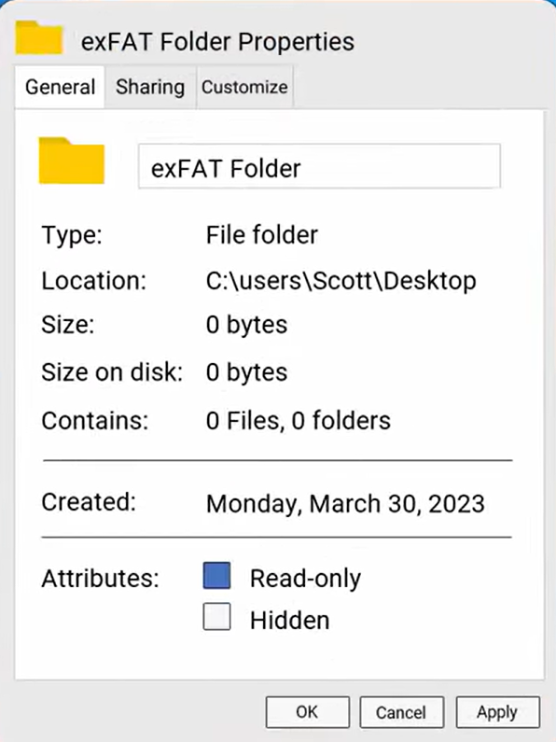
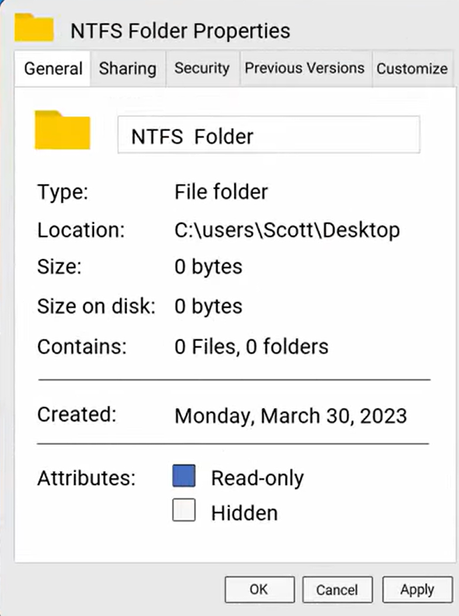
Type File System Format
FAT32
EXFAT
NTFS
8
File & Partition Size
File -> 4 GB
Partition -> 2 TB
Limitless
Limitless
File Features

Slide 9
9
File System Format | Windows | Linux | Mac OS
EXT
EXT2, EXT3, EXT4
XFS
BTRFS
NTFS
FAT32, EXFAT
APFS
HFS+
Operating System

Slide 10
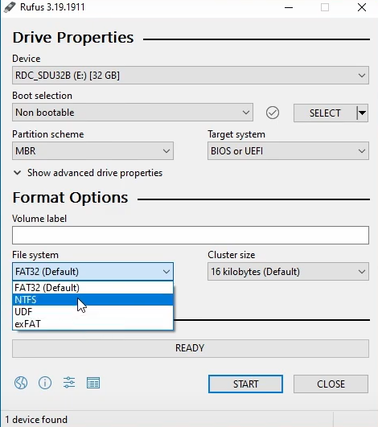
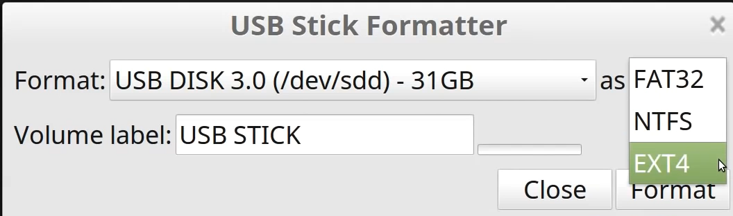
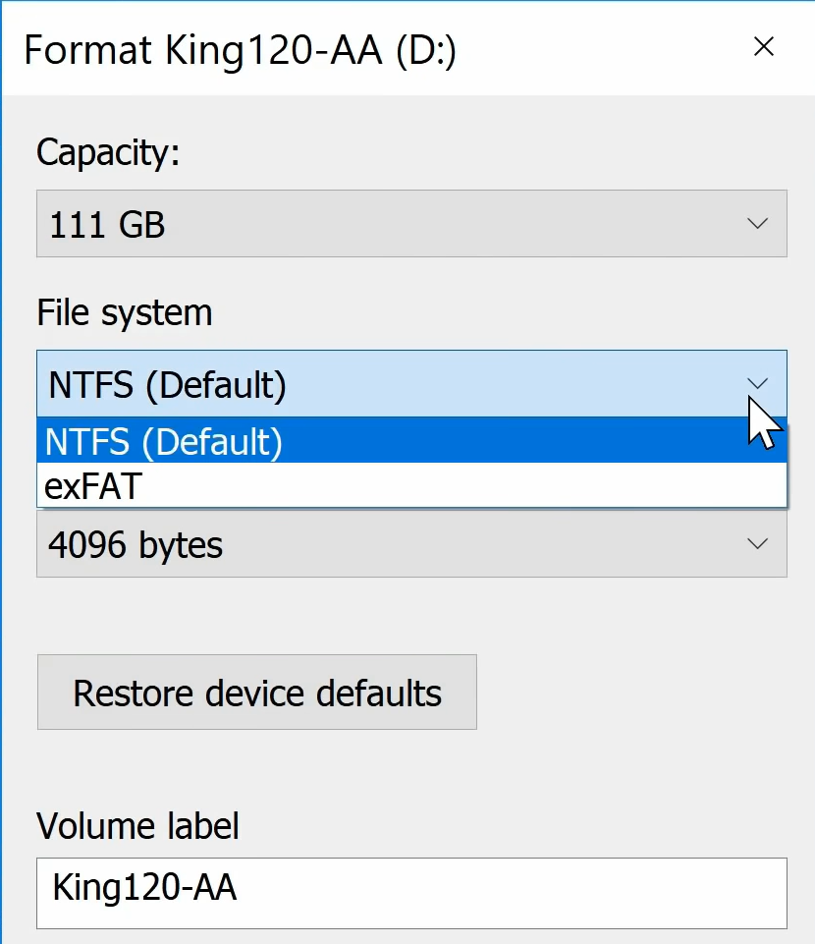
Methods to Select File System Format
10
Format USB Flash
Burn System on flash
Format Local Disk

Slide 11
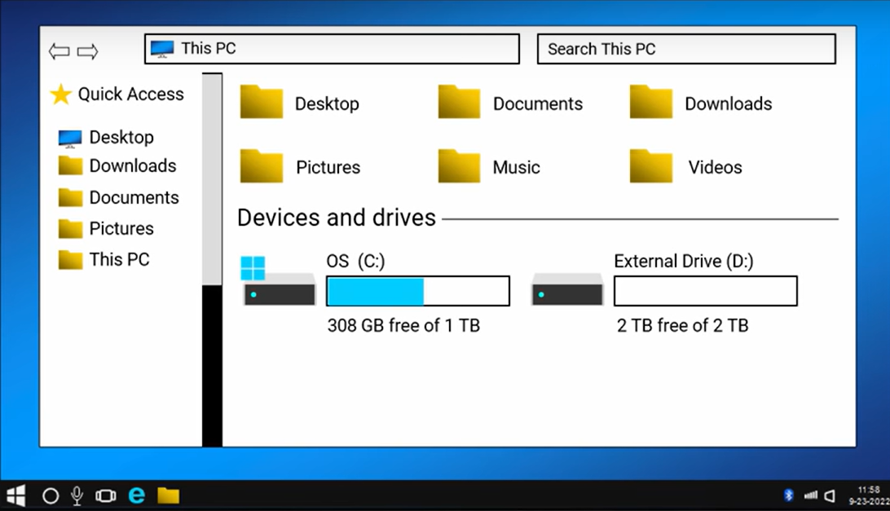
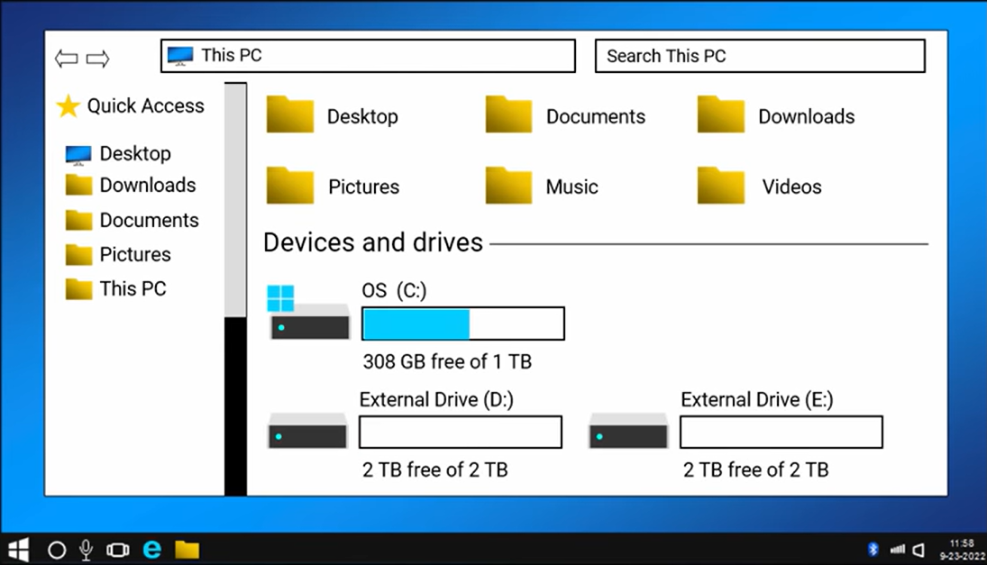
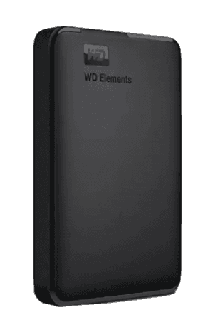
Fat32 Problems
11
4TB
4TB

Slide 12
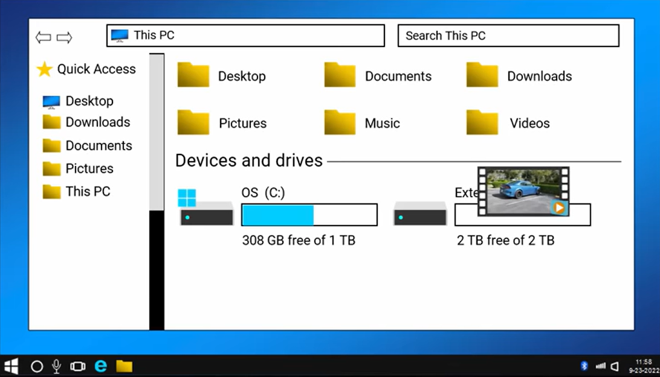
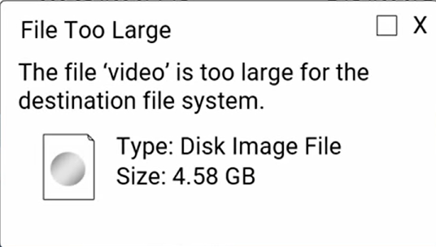
Fat32 Problems
12
2TB

Slide 13
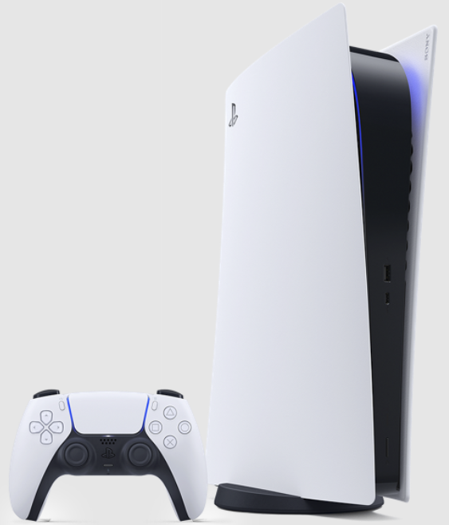
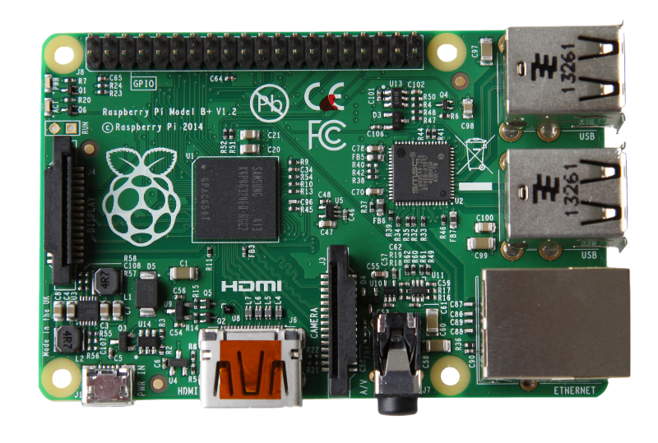
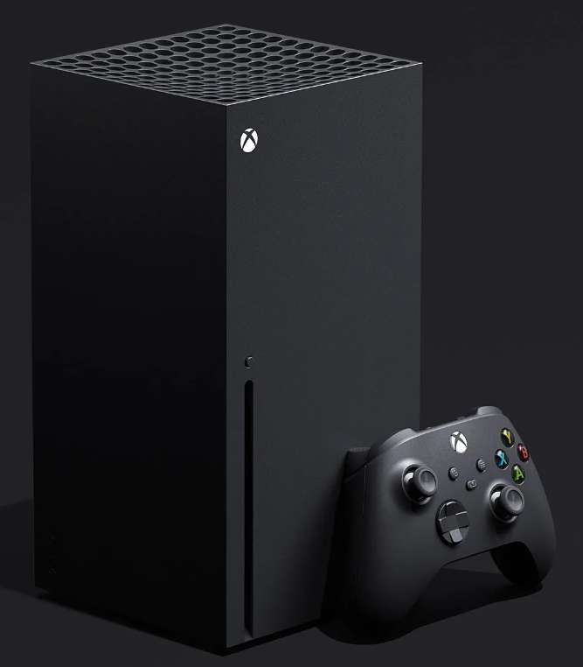
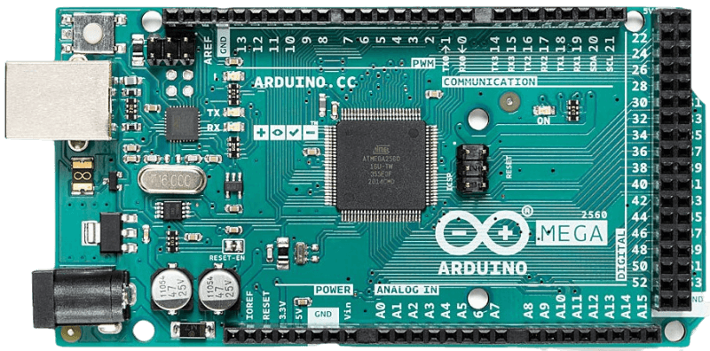


Devices & File System Format
PS
Rasberry pi
XBOX
Arduino
Mobile
Servers
13
FAT12, FAT16, FAT32, UDF, HFS+
ZFS, XFS, BTRFS, EXFAT, EXT4, FAT32
REFS, UDF, FATX, NTFS
SPIFFS, LittleFS, FAT16, FAT32
APFS, F2FS, UBIFS, EXFAT, FAT32
REFS, NFS, CIFS, HFS+, APFS, XFS

Slide 14
Conclusion
14
File system format not build in storage devices.
you can’t use different file system formats on the same partition of a storage device simultaneously.
you can divide a hard disk into two or more partitions and use different file system formats on each partition.
you can send files from one device to another even if they use different file system formats.

Slide 15
References
15
https://youtu.be/bYjQakUxeVY?si=SclZ1BNY0v9O90ql
https://youtu.be/id9qUV-S4gg?si=-HfbwI8Jku935Jln
https://youtu.be/B6kg2zeJ9do?si=SNvxhGy6YqwPLBH0
https://youtu.be/Sre0Zz7OUO8?si=rfvnM-DDxKJV7xa-
https://youtu.be/_h30HBYxtws?si=FSSxK8vfWRcamxmI
https://en.m.wikipedia.org/wiki/Comparison_of_file_systems

Slide 16

Thank you for watching
16
Do you have
any questions ?

